Slide 1
Danube Transnational Programme
Capitalisation process
EUSDR Pillar II Stakeholder Seminar
Budapest, 17.11.2017

Slide 2
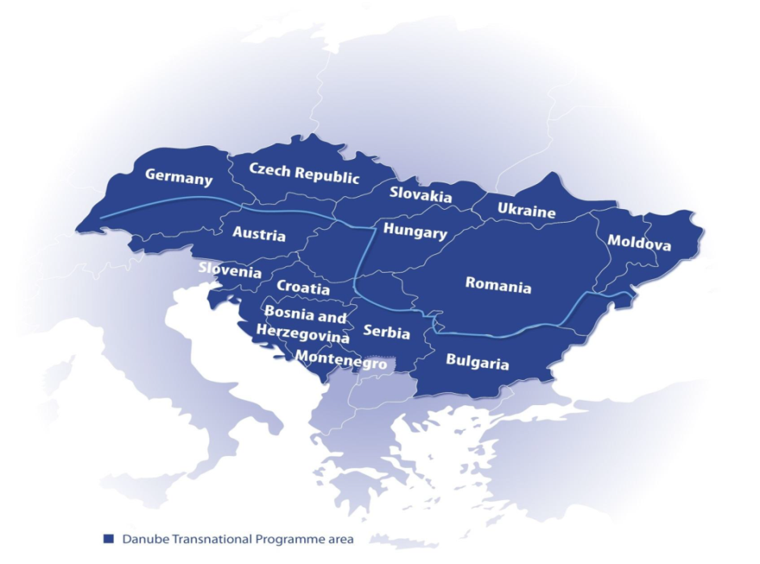
Programme area
AT, BG, CZ, DE, HU, HR, RO, SI, SK
BA, ME, RS
MD, UA

Slide 3
DTP mission
Territorial integration in Danube region
Acting as policy driver
Contribution to EUSDR objectives

Slide 4
DTP structure
Innovative and socially responsible Danube Region 1.1: Improve framework conditions for innovation 1.2: Increase competences for business and social innovation
Environment and culture responsible Danube Region 2.1: Strengthen transnational water management and flood risk prevention 2.2: Foster sustainable use of natural and cultural heritage and resources 2.3: Foster the restoration and management of ecological corridors 2.4: Improve preparedness for environmental risk management
Better connected and energy responsible Danube Region
3.1: Support environmentally-friendly and safe transport systems and balanced accessibility of urban and rural areas 3.2: Improve energy security and energy efficiency
Well governed Danube Region 4.1:Improve institutional capacities to tackle major societal challenges 4.2: Support the governance and implementation of the EUSDR

Slide 5
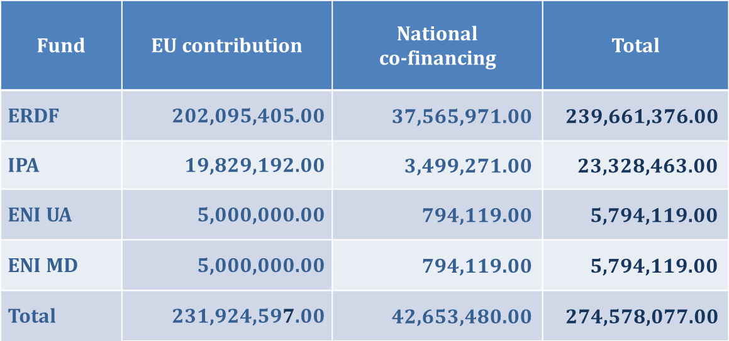
DTP budget framework
Overall DTP budget:

Slide 6
DTP and its projects
1st DTP Call – 54 projects approved & under implementation
projects in connection to water management (3) eco-corridors (2) and environmental risk management (1)
2nd DTP Call – 127 applications – 8 water + 7 eco-corridor + 6 environmental risk related (under assessment)
addressing different issues – certain thematic connections
integrated territorial approach – partnerships involve mixed sectorial actors
projects, outputs, results not to be „isolated”

Slide 7
DTP Capitalisation Strategy
strengthen links and synergies between projects of similar / connected topics
exploit and consolidate one another's achievements
fill knowledge-gaps by linking actors with complementary thematic expertise, geographical scope
increasing visibility of projects and the programme to ensure impact on policy making process
strengthen strategic thematic networks in the Programme area
Thematic Poles along 11 topics
Projects own the process
With contribution of relevant EUSDR PACs
DTP JS supports communication and coordination

Slide 8
DTP Thematic Pole 4
JOINTISZA
Danube
Sediment
Dri Danube
CAMARO-D
sediment management along Danube River
joint, integrated river basin and flood risk management plan for Tisza River
steering land use to safeguard water resources and reduce flood risk
regional drought management and emergency response strategy, monitoring system and tools

Slide 9
Cooperation in action
4 projects
13 countries
55 PPs
36 ASPs
EUSDR PA4&5
cooperation in pilot actions
Workshop at EUSDR Annual Forum
joint conferences, stakeholder events
Involvement in PA4 & 5 SG meetings and events
cross-sectorial project linkages

Slide 10
DTP Thematic Pole 5b
DANUBE
parks
CONNECTED
Coop MDD
Danube GeoTour
ECO KARST
LENA
enhance framework for planned TBR UNESCO “Mura-Drava-Danube”
sustainable tourism development in geo-parks
connectivity along Danube river habitat corridor in connection to national parks
protection & sustainable use of natural heritage of karst bio-regions
trigger economic development in Natura 2000 sites

Slide 11
Cooperation in action
cooperation meetings
joint conferences, stakeholder events
5 projects
14 countries
59 PPs
31 ASPs
EUSDR PA6
workshop at EUSDR Annual Forum
cross-sectorial project linkages
connection to PA6

Slide 12
DTP Capitalisation process
Information source:
http://www.interreg-danube.eu/relevant-documents/dtp-capitalisation-strategy

